Slide 1

Predicting Job Offers based on Technical and commucation skills using Neural Networks
Navya Sri, Medidhi
@01413557

Slide 2
Neural Networks
It can learn by examples.
This is inspired by the biological neuron system
It has many highly interconnected processing elements called neurons, which are used to solve the problems
Information follows a non-linear path and process in parallel throughout the nodes.
It is a complex adaptive system.(ability to change its structure by the adjusting inputs.)
To be cont.

Slide 3
Designed to solve problem which are easy for humans and difficult for machines. (like identifying pictures and patterns)
Its application ranges from object identification and detection.
Inspired by the human brain to perform a particular task or function.

Slide 4
Propagation:
FeedForward:
This network is not the recursive. Neurons in this layer only connected to neurons next layer, and they don’t form a cycle.
Signals travel in only one directions towards the output layer.
FeedBack:
This contains cycles. Signals travel in both directions. Feedback cycles can cause the networks behavior change over time based on its input.
Also known as recurrent neural networks.

Slide 5
Procedure:
Human brain consists of billions of neural cells that process information.
Each neural cell considered a simple processing system.
The interconnected web of neurons known as biological neural network transmits information through electrical signals.
This parallel interactive system makes the brain to think and process information.
Dendrites of a neuron receive input from other neuron and respond output based on those inputs to an axon of some other neuron.
Synapses is a point of interaction of neurons. (Conjunction)

Slide 6
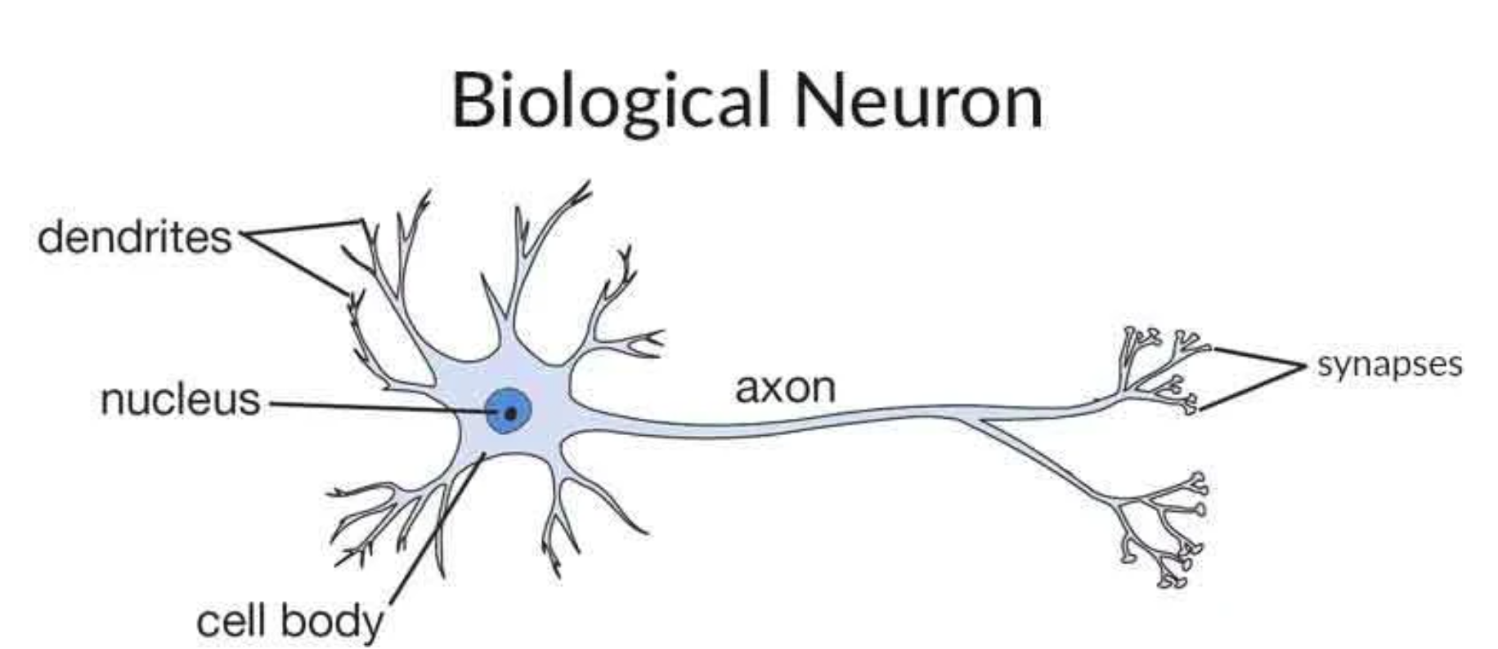

Slide 7
Activation Function:
This defines the output of a neuron in terms of a local induced field.
It is a single line of code that gives the neural nets non linearlity and expressiveness.

Slide 8
Types of functions:
Identity function: that maps input to the same output value. Also called as straight-line function where activation is proportional to the input.
Binary step Function: if a value of Y is above a threshold then the output is True(or activated), and if its less than the threshold then the output is False(or not activated). It is very useful in the classifier.
Sigmoid Function: is s shaped function. Logistic and hyperbolic tangent functions are commonly used sigmoid functions.
Binary sigmoid function is a logistic function where the output values are varying from 0 to 1.
Bipolar sigmoid function is a logistic function where the output value varies from -1 to 1. also known as Hyperbolic Tangent Function or tanh.

Slide 9
Ramp Function: is derived from the appearance of its graph. It maps negative to 0 and positive inputs to the same output.
Relu stands for the rectified linear unit. It is the most used activation function in the world. It output 0 for negative values of x.

Slide 10
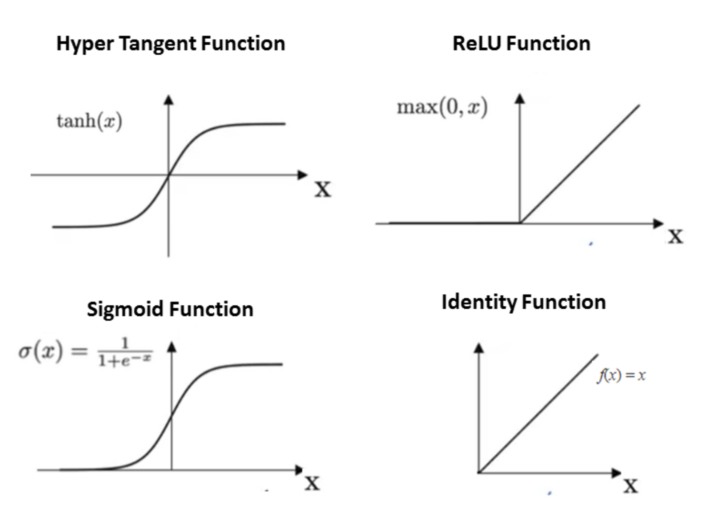

Slide 11
Impementation in R
Install packages
Loading data
Making sure all the columns or features are in single set of data.
Splitting the data into train and test.
Creating Neural Network model for train dataset.
Plotting the NN model.
Predicting the values for test dataset using NN model created from train dataset.
R markdown doc

Slide 12
Advantages and Disadvantages:
Pros
More flexible and can do both regression and classification problems.
Good for nonlinear dataset with many inputs and layers.
Cons
There are more alternative algorithms which are simple, fast, easy to train and provide better performance.
More time taking for development and more computation power.
Need more data that are numerical and non missing datasets than other algorithms.

Slide 13
Use Cases
Pattern recognition: like facial recognition, object detection, fingerprint recognition etc.
Time series prediction: like stock price, weather forecasting.
Natural language processing: like text classification, Named Entity Recognition, part of speech tagging, Speech Recognition, and Spell Checking.

Slide 14
Conclusion:
This is the detailed description about the neural network. What is neural network, Forward and backward Propagation, along with Activation Functions, Implementation of the neural networks in R, use cases of NN and finally Pros and Cons of NN.

Slide 15
References:
https://www.datacamp.com/community/tutorials/neural-network-models-r

